Slide 1
Surgical Management of Chronic Pancreatitis
Dr Kaisha W
HPB Surgeon

Slide 2
Pathophysiology
Long-standing and progressive inflammation of the pancreas
Replacement of normal parenchyma with fibrotic scarring.
This destruction of the normal pancreatic architecture
Ultimately exocrine and endocrine dysfunction

Slide 3
Common complications associated with CP are
  Pancreatic and/or biliary duct strictures,
  Pancreaticolithiasis,
  Pancreatic fistulas and pseudocysts,
  Ultimately recurrent or persistent pain.

Slide 4
Risk Factors
Heavy alcohol consumption is most common
TIGAR-O classification system,
  toxic-metabolic,
  idiopathic,
  genetic,
  autoimmune,
  recurrent acute pancreatitis
  obstructive groups.
CP x15-fold increased risk of pancreatic cancer.

Slide 5
Abdominal pain is the most debilitating symptom
Increase pancreatic intraductal and intra-parenchymatous pressure
symptomatic pseudocysts.
Pancreatic neuropathy due to
  neuronal hypertrophy
  neuritis causing altered nociception with peripheral and central sensitization of the nervous system
central sensitization may explain the persistent pain despite total pancreatectomy (TP) in which the root cause of pain should be removed in its entirety.
The inflammatory mass in the head of the pancreas is the ‘pacemaker’ of pain

Slide 6
Management of CP
Complex and multidisciplinary approach
  surgeons
  gastroenterologists
  Radiologists
  pain management physicians.

Slide 7
Management
In current clinical practice
  conservative management is employed as a first-line approach
  before considering more invasive therapy such as endoscopic intervention or surgery.²
Evidence shows that early surgery should be favoured over surgery at a more advanced stage of the disease.^{1,2,}
United Eur Gastroenterol J. 2017;5(2):153–99.
JAMA. 2020;323(3):237–47.

Slide 8
STEP-UP APPROACH AND SURGICAL INDICATIONS
First line-treatment for CP is conservative therapy
  Medical analgesics WHO ‘pain relief ladder’
  Exocrine and endocrine replacement therapy
  lifestyle : cessation of alcohol and smoking
  Opioids
    fail to achieve pain relief in up to 50% of patients
    adverse effects : abuse potential, opioid-induced hyperalgesia and risk of painful narcotic bowel syndrome with prolonged usage

Slide 9
Endoscopic Therapy(ET)
ET such as ERCP with an obstructive form due to stones or strictures in the main pancreatic duct (MPD).
ET decompresses the pancreatic duct
  stone removal,
  dilatation,
  and stenting of strictures.
Successful ET: patients remain pain-free a year after stent removal.
The HaPanEU/UEG: recommend ET for uncomplicated CP and dilated MPD after failed medical therapy.
If ET fails to achieve any pain relief at 6–8 weeks, surgical options should be considered.

Slide 10
ESWL combined with ET, for larger obstructive radiopaque stones (≥5 mm)
  successful in 76% of patients after 6 months ie complete resolution of pain, no analgesic treatment and no surgical treatment.¹
EUS-guided coeliac plexus block,
  used for pain control for pancreatic cancer pain,
  effective only for 50% of CP patients
  only 10% remain pain free after 24 weeks.²
Efficacy and safety of extracorporeal shock wave lithotripsy for chronic pancreatitis. Scand J Gastroenterol. 2016;51(11):1380–5.
Endoscopic ultrasound‐guided celiac plexus block for managing abdominal pain associated with chronic pancreatitis: a prospective single center experience. Am J Gastroenterol. 2001;96(2):409–16.

Slide 11
Indications and goals of Surgery
Indication for surgery
  intractable pain.
  a suspicion of neoplasm
  local complications of adjacent organs such as duodenal or common bile duct stenosis.
Main goals
  long-term pain relief
  Treating CP-associated complication,
  improving of quality of life (QoL)
  achieving maximum preservation of pancreatic function.

Slide 12
SURGICAL THERAPY
Three categories:
  drainage,
  resection and combination of drainage and resection procedures,
  DPPHR: Duodenal preserving pancreatic head resection
The operation recommended is based on
  pancreatic duct anatomy
  distribution of the disease in the gland e.g., inflammatory mass in the pancreatic head/tail

Slide 14
a: Drainage: Partington-Rochelle or modified Puestow.
b: PD
C: DPPHR: Beger procedure
d: DPPHR modification: Frey procedure
e: DPPHR modification :Berne procedure

Slide 15
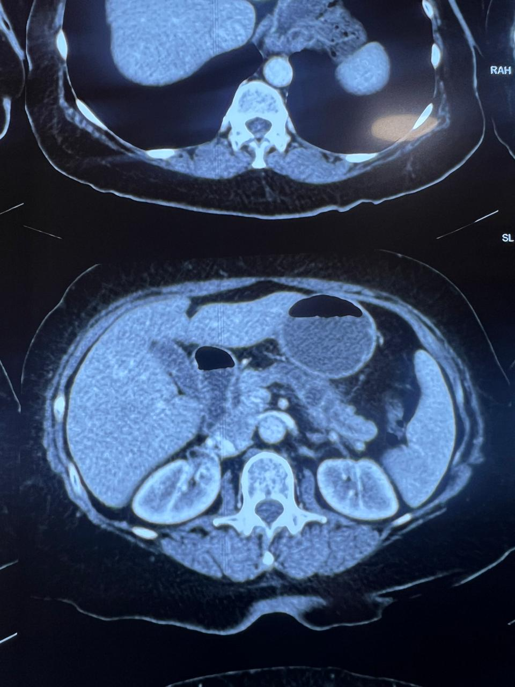
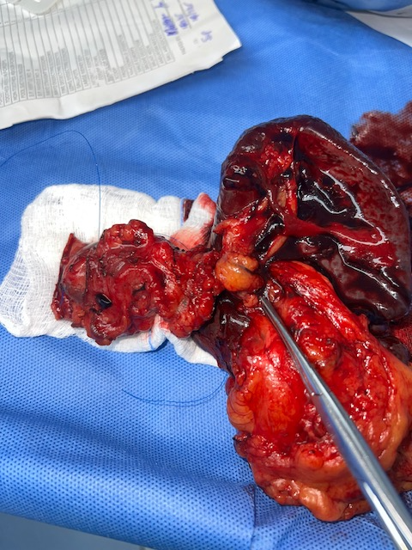

Slide 16
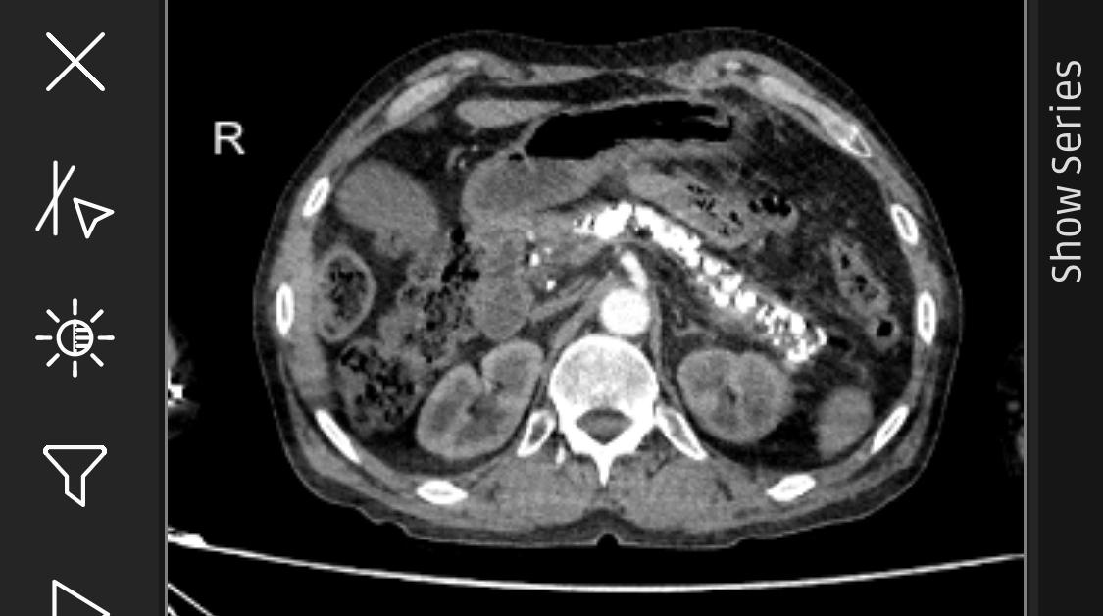

Slide 17
TIMING OF SURGERY
A dilemma.
Currently a last resort after medical and ET
Daily opioid use and high numbers of endoscopic attempts prior to surgery are associated with failure to achieve adequate long-term pain relief and improved QoL in patients with CP.
International consensus guidelines for surgery and the timing of intervention in chronic pancreatitis. Pancreatology. 2020;20(2): 149–57.

Slide 18
Postponement of surgical intervention results in
  Prolonged periods of pain
  More advanced disease stage, with the potential to produce central sensitization and neuropathic pain

Slide 19
Timing of Surgery
A cross-sectional study of 266 patients with painful CP showed that early surgery (within 3 years) of symptom onset was¹
  correlated with better QoL,
  lower rates of endocrine insufficiency
  more pain relief.
surgery prior to opioid usage and multiple Ets (five or fewer) was associated with higher rates of pain relief in a mean follow-up of 62 months.
Corroborated by a different study suggesting that early surgical intervention within 26.5 months or less of CP diagnosis was associated with better pain control and preservation of pancreatic function.²
Clinical outcome in relation to timing of surgery in chronic pancreatitis: a nomogram to predict pain relief. Arch Surg. 2012;147(10):925–32.
Surgery for chronic pancreatitis: the role of early surgery in painmanagement. Pancreas. 2015;44(5):819–23.

Slide 20
Timing of Surgery
Cahen et al.¹ study was pre-terminated by the safety committee after an unscheduled interim analysis
  RCT comparing ET (n = 19) and surgical drainage (Partington-Rochelle) (n = 20)
  lower Izbicki pain scores, after a median of 2 years follow-up, in the surgical group (25 vs. 51, p < 0.001).
  Pain relief 75% ( surgical drainage) vs 32% ET (p = 0.007).
Surgical patients required fewer procedures (a median of 3 vs. 8, p < 0.001)
Long-term follow-up period of 7-year,
  surgically treated experienced more pain relief (80% vs. 38%, p = 0.042),
  Accomplished in a single operation VS multiple in ET ²
Based on these outcomes (short-and long-term), the authors suggested that surgery is superior to endoscopic treatment in patients with advanced painful CP.
Endoscopic versus surgical drainage of the pancreatic duct in chronic pancreatitis. N Engl J Med. 2007
Long‐term outcomes of endoscopic vs surgical drainage of the pancreatic duct in patients with chronic pancreatitis. Gastro- enterology. 2011;141(5):1690–5.

Slide 21
Timing
Issa et al conducted the ESCAPE trial in 2020.
88 patients with CP were randomly allocated to either the early surgery group or ET first approach
At 18 months the early surgery
  had a lower reported Izbicki pain score (37 vs. 49, p = 0.02).
  fewer number of interventions (median 1 vs. 3, p < 0.001).
  one-third of ET first were referred to surgery
  medical pain management as a first-step treatment failed in nearly all patients.
Effect of early surgery vs endoscopy‐first approach on pain in patients with chronic pancreatitis: the ESCAPE randomized clinical trial. JAMA. 2020;323(3):237–47.

Slide 22
Timing
Simply put, these studies are making a good argument against the current step-up approach for the treatment of CP and advocating earlier surgical intervention.
Despite this, clinical practice has not yet changed since ET is still preceding surgery in many cases.

Slide 23
Minimal Access Techniques ( MAS)
Application in CP is disproportionally low.
Technical difficulties and risk of intraoperative haemorrhage
Robotic assisted surgery in patients with CP is gaining momentum.
MAS for CP will gain more traction in the coming years

